Slide 1
AN ASSESSMENT OF REPRDUCTION AND KIDDING PATTERN OF ASTORE MARKHOR (capera falconeri falconeri) IN GILGIT BALTISTAN
Submitted By
Israr Hussain
M.Phil
Registration No.: 2019-KIU-7188
Session (2019-2021)
Submitted To
Dr. Muhammad Zafar Khan (Supervisor)
Karakoram International University Gilgit
Dr. ­­­­­­Saeed Abbas (Co-Supervisor)
International Union for the Conservation of Nature Pakistan
__________________________________________________________________
Department of Environmental Science Karakoram International University Gilgit-Baltistan, Pakistan

Slide 2
Table of Content
Introduction
Research Problem
Objectives of Study
Significance of Study
Justification of Study
Material and Method
Work plan

Slide 3
Introduction
Astore markhor (Capra falconeri falconeri) belongs to the Carpinae group of the Bovidae family (Schaller, 1977; Roberts, 1977) were first described by Wagner in 1839 (Huffman, 2004).
Five sub-species are reported from Pakistan, namely: Astore Markhor, Kashmir Markhor, Suleiman Markhor, Kabul Markhor and Bukhara Markhor and almost all are categorized as “Endangered” (IUCN, 2015).
Markhor are found in the South Asian countries of Pakistan, India, and Afghanistan, and in the Central Asian countries of Turkmenistan, Tajikistan, and Uzbekistan (Schaller, 1977).
Markhor have a wider distribution in Pakistan than in any other country (Hess et al., 1997).
Markhor are social animals and live in small herds. The herds consist of females, their kids, yearlings and young males. Mature males live alone outside the herds and only join the herds during the winter rut season in late December (Roberts, 1977).

Slide 4
December is the rut season and it continues for one month up to January. According to Roberts (1977) gestation period is approximately six months while the age of maturity for reproduction of female in straight-horned markhor is about three years.
Markhor are diurnal feeders and graze/browse mostly early in the morning and late in the evening. They can be seen feeding irregularly during winter throughout the day (Roberts, 1977).
The age of maturity for reproduction for female in straight-horned markhor is about three years (Roberts, 1977) while for the female of flare-horned markhor, it is two years (Aleem and Malik, 1977).

Slide 5
In Gilgit the young are born at the end of May to early June which would indicate a gestation period of about 160 days. Similarly in Baluchistan the young are born early in April. Other authorities have given the gestation period as varying from 147 to 180 days (H. Vass, 1961; Walker et al., 1964).
Haller (1992) were noticed that Lower female to kid ratio is probably due to higher mortality and predation on younger crop and may also be due to low reproduction and over harvest of productive males for trophies inside CMCAs (Khan, 2011 & Loveridge, 2006).

Slide 6
Khan et al. (2014) identified wider distribution of markhor in the Karakoram, Himalayas and Hindu Kush mountain ranges encompassing Darel, Tangir, Chillas, Sakwar, Jutial, Barmas, Kargah, Rahimabad, Jaglote, Sikandarabad, Bunji, Asotre and Skardu districts of Gilgit-Baltistan. A total of 1071 animals including 331 males, 452 females, 273 yearlings and 15 kids were recorded from 09 valleys. Considerably, larger herds were sighted in community managed conservation areas of Skoyo-Karabathang-Basingo (SKB), Bunji, and Jutial but other significant populations were also reported from Danyore, Sikandarabad and Jaglote valleys. Rahimabad and Jaglote Goor are still considered to be the potential habitats of markhor.

Slide 7
Trophy hunting is a significant wildlife management strategy in many countries of Asia, Africa, and Europe (Lechuga, 2001) that has resulted in a positive change in attitudes of local people towards wildlife, the active involvement of communities in natural resource projects, and the achievement of conservation goals (Lewis and Alpert 1997, Baker 1997a).
Mountain ungulates around the world have been threatened by illegal hunting, habitat modification, increased livestock grazing, disease and development (Kulbhushansingh et al., 2012).
Frisina et al. (2002) stated that various diseases are transmitted to markhor through domestic goats and sheep.

Slide 8
Research Problem
Markhor is classified as endangered species by the IUCN, (2015).There are number of threats to this species that are poaching illegal hunting, and Habitat loss. In Gilgit Baltistan illegal hunting is one of the major threats to this species. So the least known species seek for special care for its survival and conservation. Presently, the knowledge is very limited about population dynamics of Astore markhor in GB, especially the information on reproduction and kidding is either very scanty or absent. More importantly, the Astore markhor populations which are fragmented and occur mostly in isolations due to the geographical barriers, it is very important to understand the current status of their reproduction. Secondly, some populations in GB are subject to trophy hunting. It has been widely recommended to monitor the population dynamics of the hunted species (Khan et al., 2019). Therefore the current study aims to assess the reproduction and kidding of Astore markhor in GB.

Slide 9
Objectives of the study
The objectives of Study is following
Asses the distribution and population dynamics of Astore markhor during kidding seasons;
To determine the reproductive rates and kidding patterns;
To explore management prescriptions for breeding populations of Astore markhor.

Slide 10
Significance of the Study
The study will explore useful information about breeding populations of Astore markhor including distribution of kidding populations, reproductive rates, survival of kids, etc, which is quite useful to understand the overall population dynamics of Astore markhor in GB. In the long run it will be helpful for wildlife managers to prioritize their conservation actions across different areas of markhor distribution and future recommendations for trophy hunting allocations.

Slide 11
Justification of the study
The present study proposed, because knowledge is very limited on population dynamics of Astore markhor. In the light of available literature it would a firt dedicated attempt to understand the kidding pattern of Astore markhor in GB. The results of this study could be useful to rectify the situation of management, especially after presentation of its results to the stakeholders’ i.e. Governmental departments, NGOs and local communities.

Slide 12
Material And Methods
Study Area:
GB (71-75 o N; 32-37° E; 70,332°, 72,971 km²) consists of towering snow-covered mountains, deep gorges and narrow valleys. The fast running streams ultimately drain into the River Indus. The Karakorum, Hindu Kush and Himalaya ranges knot in the center of GB and diverge in different directions. The Karakorum and Hindu Kush have northwestern and southwestern orientations, respectively. The east-west oriented Himalayas occupy southern parts of GB. The Himalayas receive more liberal precipitation during the summer and winter monsoon (mean annual precipitation = 180 cm). They are therefore greener, supporting Himalayan dry temperate mountain forest, sub-alpine and alpine forest (Champion et al., 1965).
Northern parts (Karakorum and Hindu Kush) have scanty summer rains, thinner vegetation and greater wind and water erosion. Climatically, GB falls in temperate zone. Winter temperatures remain below freezing for most of the year. The human population (0.7 million) is concentrated in major towns along streams. Small human settlements, groups of family houses and nomadic camps are scattered throughout GB (Fakhar-i-Abbas et al., 2015).

Slide 13
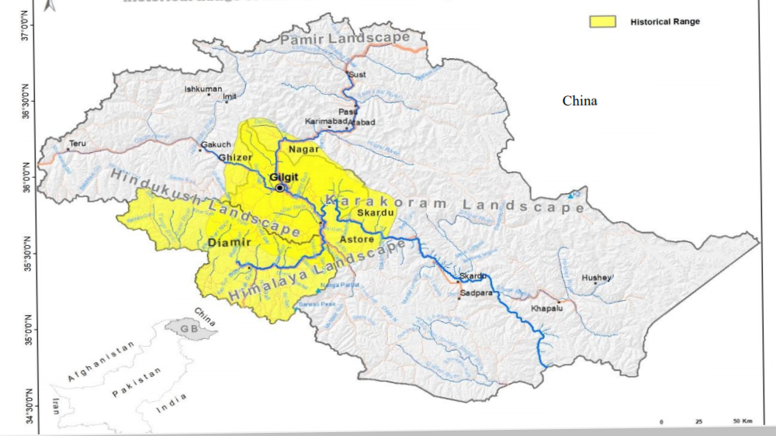
Historically markhor are distributed in many areas of Gilgit Baltistan including Astore, Skardu, Gilgit, Ghizer, Diamer (Figure 1). The present survey will be conduct in four Districts of Gilgit Baltistan, namely; Astore, Gilgit, Diamar and Nagar).

Slide 14
Methodology
The method is considered one of the reliable techniques worldwide for studying ungulate ungulates populations (Kulbhushansingh et al., 2012).
The double-observer survey method uses the robust frame-work of mark–recapture theory to estimate population size (Caughley, 1974).
We divided survey team members into two groups (observer A and observer B). They will be asked to maintain the temporal distance throughout the survey without giving cue each other and 30 minutes of temporal separation will ensured between the observers. Both observers will use the binocular after covering the distance of the 100m to scan the whole area thoroughly, moving through the predetermined trails without indication for each other. During the survey if observer “B” finds the observer “A”, he will pause until the observer “A” disappears. We will use the GPS for the coordinates of the herd’s location, binoculars and spotting scope for observation of herds. We wrote the finding on survey sheet, at the end of the day, both observers will compare their data either they observed the same herds or different herds to avoid double counting.

Slide 15
Analytical Approach
Population will be estimated by using Capture Mark- Recapture Method in (Specific MS Excel-2013 formats) based on the formulas (Forsyth and Hickling, 1997).
Where:
B= Number of groups seen by both observers
S₁= Groups seen by observer first
S₂= Groups seen by observer second
Ĝ= Estimated number of groups
Û= Mean Group size
N= Estimated population

Slide 16
Statistical Analysis
Required Equipment's
The data will be analyzed through descriptive statistics, presented in graphs and tables, the data analysis in SPSS (statistical Package for Social Sciences), T test were used to compute ratios among different sex and age classes. While, Variance test and Standard deviation also apply for determine variation, also find Frequency distribution for all population (Female, Male, and Kids etc.) as well as determine relationship between Reproduction and Kids and compered ratio among sites of different districts. Geographical Information system (GIS) will be incorporated in the research for better results.
The required equipment's are following;
Survey sheet
Gps
Binocular
Spotting scope
Camera
Pen/notebook

Slide 17
Work plan
Time frame
Experimental design, layout and execution | 1 year
Review of literature/ literature cited collection and management | April 2020
Data collection (kidding) | August-2020
Data collection (winter population and kids survival) | December 2020
Data tabulation | Septembar-2020 December-2020
Data analysis | Sep-Oct 2020 Dec 2020-Jan 2021
Results/findings and their linkup with basic/ground theories
Submission of 1st draft of thesis/ dissertation | March 2021

Slide 18
The End
If any Question?

